Slide 1

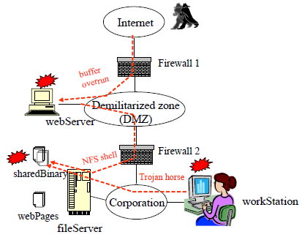
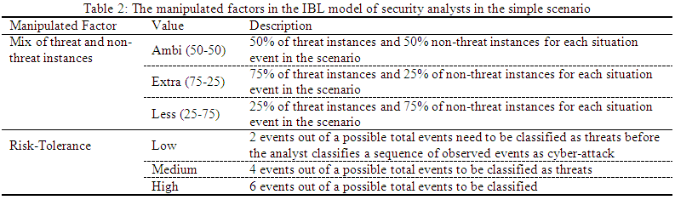
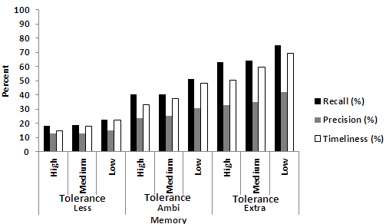
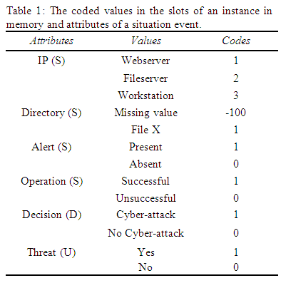
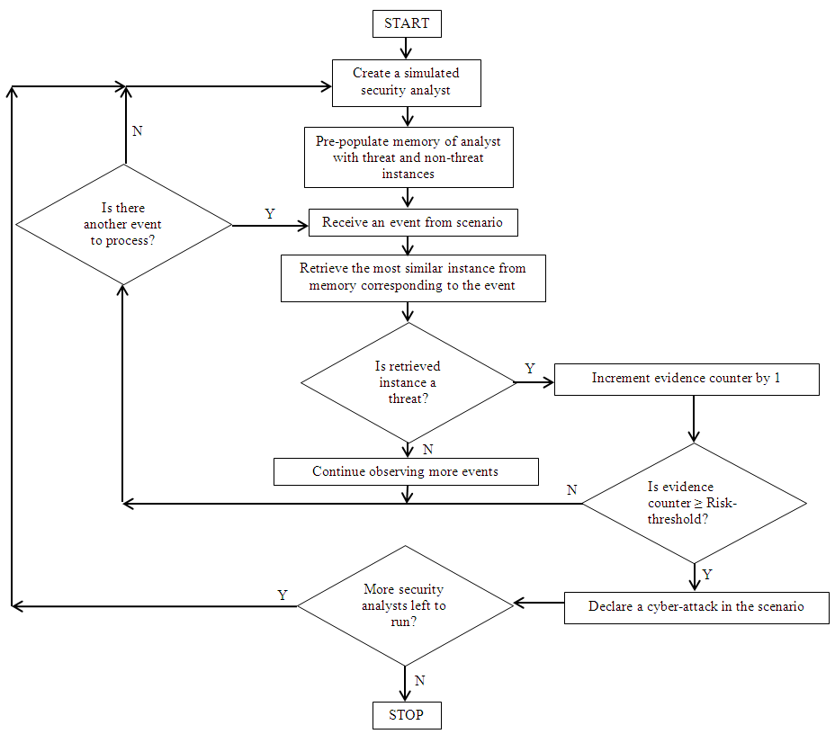
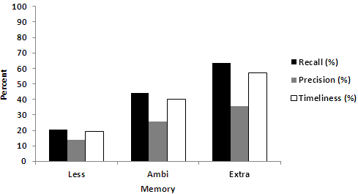
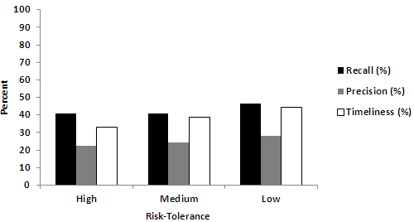



Cyber Situation Awareness: Modeling the Security Analyst in a cyber-attack scenario through Instance-based Learning
VARUN DUTT (varundutt@cmu.edu), YOUNG-SUK AHN (ysahn@altenia.com), & CLEOTILDE GONZALEZ (coty@cmu.edu)
Dynamic Decision Making Laboratory (www.cmu.edu/ddmlab), Carnegie Mellon University
A Security Analyst in a Corporate Network
Methodology
Methodology and Results
Results & Discussion
Introduction
According to President Obama’s office, the nation’s cyber-security strategy is twofold (Whitehouse, 2009):
Improve our resilience to cyber incidents; and,
Reduce the cyber threat.
Meeting both these objectives requires cyber situation-awareness (cyber-SA), a three stage process consisting of (Endsley, 1995; Tadda et al., 2006):
Recognition: Awareness of the current situation in the network
Comprehension: Awareness of malicious behavior in the current situation in the network; and,
Projection: Assessment of possible future courses of action resulting from the current situation in the network
Key role is that of a security analyst: A decision-maker who is in charge of observing the online operations of a corporate network from threats of random or organized cyber-attacks (Gardner, 1987; Johnson-Laird, 2006)
Objective: To describe a cognitive model of the recognition and comprehension processes of a security analyst ,where the model is based on the Instance-Based Learning Theory (IBLT, Gonzalez, Lerch, & Lebiere, 2003; Gonzalez & Dutt, 2010, hereafter, IBL model)
The IBLT is well suited to modeling the decisions of a security analyst (Gonzalez & Dutt, 2010; Dutt, Cassenti, & Gonzalez, 2010).
A Simple Cyber-attack Scenario (Island-hopping attack)
Figure 1: A simple scenario of a cyber-attack consisting of 25 cyber events. Each
event contains four attributes: IP address, directory, alert, and operation. The
attacker (shown as a black person) tries to gain access of a company’s fileserver
indirectly through the company’s webserver. Source: Xie et al. (2010).
Parameters and Dependent Variables
The IBL model was developed in Matlab; run for 500 simulated analysts and over 25 events in the simple scenario for each analyst
Instances in the model are retrieved from memory based upon their activation (A_{i}). Parameters set at defaults: d = 0.50; s = 0.25; Squared-similarity function used between attributes of an event and the S slots of an instance
Dependent variables: Performance of a simulated analyst was measured using accuracy and timeliness of the analyst (Jajodia et al., 2010) as per the following:
Recall or hit-rate (accuracy): it is the percent of events correctly detected as threats out of the total number of known threat events observed by the model before the model stopped.
Precision (accuracy): it is percentage of events correctly detected as threats out of the total number of threat events detected by the model before the model stopped
Timeliness: it is 100%-percentage of events, out of total events, after which the model stops and classifies the scenario to be a cyber-attack
Results Summary
Extra-careful analyst with a low risk-tolerance performs better compared to less-careful analyst with a high risk-tolerance
Risk-tolerance and memory seems to impact all three performance measures
Precision is always smaller than the Recall and Timeliness measures
Effect of memory is more impacting performance measures compared to the effects of risk-tolerance of the analyst
Background
Literature indicates that the SA of a security analyst is a function of:
(1). A priori experiences and knowledge level (memory) of the analyst about a cyber-attack scenario (Jajodia et al., 2010)
(2). The willingness of the analyst to take risks, i.e., analyst’s risk-tolerance (McCumber, 2004; Salter et al., 1998)
However, there is a lack of a study that empirically investigates the role of both the above factors on the cyber SA of a security analyst through cognitive models
We use IBLT to develop a cognitive model of the security analyst and we assess the effects on the above two factors on the accuracy and timeliness of the analyst to detect cyber-attacks in a cyber-attack scenario
Discussions
Proposed that computational models based on the IBLT can be used to make predictions of the cyber SA of a security analyst
Concrete predictions of the level of recall, precision, and timeliness of the security analyst given some level of experience and risk-tolerance
Risk-tolerance level and the mix of threat and non-threat instances in analyst’s memory affect the analyst’s cyber SA
Predictions need to be validated with human data, i.e., observed behavior form a human security analyst in the simple scenario.
We plan to run laboratory studies in the near future to assess human behavior
IBL Model of a Security Analyst in the Simple Scenario (Figure 2)
Results (Figure 3)
Instance Based Learning Theory
IBLT is a theory of how people make decisions from experience in dynamic tasks (Gonzalez et al., 2003)
IBLT proposes that people represent every decision-making situation as instances that are stored in memory. An instance in IBLT is composed of three parts: situation (S), decision (D), and utility (U)
For each decision-making situation, an instance that is most similar to the current situation is retrieved from memory and is used to make decisions
Retrieval of instances is based upon activation (A_{i}) (borrowed from the ACT-R framework, Anderson & Lebiere, 1998) which is function of recency and frequency of use of instances and their similarity to a situation in the environment:
Acknowledgement
This research was a part of a Multidisciplinary University Research Initiative Award (MURI; # W911NF-09-1-0525) from Army Research Office for a research project on Cyber Situation Awareness.
References
Anderson, J. R., & Lebiere, C. (1998). The atomic components of thought. Mahwah, NJ: Erlbaum.
Endsley, M. (1995). Toward a theory of situation awareness in dynamic systems.
Human Factors Journal, 37(1), 32–64.
Dutt, V., Cassenti, D.N., & Gonzalez, C. (2011). Modeling the role of the robotics operator manager in a tactical battlefield. In
Proceedings of IEEE CogSIMA 2011 Annual Meeting.
Gardner, H. (1987). The Mind’s New Science: A History of the Cognitive Revolution. New York, NY: Basic Books.
Gonzalez, C., & Dutt, V. (2010). Instance-based Learning: Integrating Decisions from Experience in Sampling and Repeated
Choice Paradigms. Manuscript submitted for publication.
Gonzalez, C., Lerch, F. J., & Lebiere, C. (2003). Instance-based learning in real-time dynamic decision making. Cognitive
Science, 27 (4), 591–635.
Jajodia, S.; Liu, P.; Swarup, V.; Wang, C. (Eds.). (2010). Cyber Situational Awareness. New York, NY: Springer.
Johnson-Laird, P. (2006). How We Reason. London, U.K.: Oxford University Press.
McCumber, J. (2004). Assessing and Managing Security Risk in IT Systems: A Structured Methodology. Boca Raton, Florida: Auerbach Publications.
Salter, C., Saydjari, O., Schneier, B., & Wallner, J. (1998). Toward a Secure System Engineering Methodology. In Proceedings of New Security Paradigms Workshop (pp.). Charlottesville, VA.
Tadda, G., Salerno, J. J., Boulware, D., Hinman, M., Gorton, S. (2006). Realizing situation awareness within a cyber environment. In Proceedings of SPIE Vol. 6242 (SPIE, Bellingham, WA, 2006) (pp. 624204). Kissimmee, FL.
Xie, P., Li, J. H., Ou X., Liu, P., Levy, R. (2010). Using Bayesian networks for cyber security analysis. In proceedings of the 2010 IEEE/IFIP International Conference on Dependable Systems and Networks (DSN) (pp. 211 - 220). Hong Kong, China.
Whitehouse. (2009). Cybersecurity. Retrieved October 31, 2010, from The Whitehouse Website: http://www.whitehouse.gov/the_press_office/Remarks-by-the-President-on-Securing-Our-Nations-Cyber- Infrastructure/.

